Slide 1
CASE STUDY: SWIMR
Building an Azure Serverless Computing Mobile Application

Slide 2
About me – RICHard CRANE
Co-Founder/CTO of MILL5
Microsoft Alumni (10+ Years)
Author of Essential WCF by Addison Wesley
SQL Server Certified Master
Building a high-end boutique consulting company where developers are able to do their best work and have fun while doing it
Having fun being on the bleeding edge of IoT, Azure, SaaS, Mobile, and more.

Slide 3
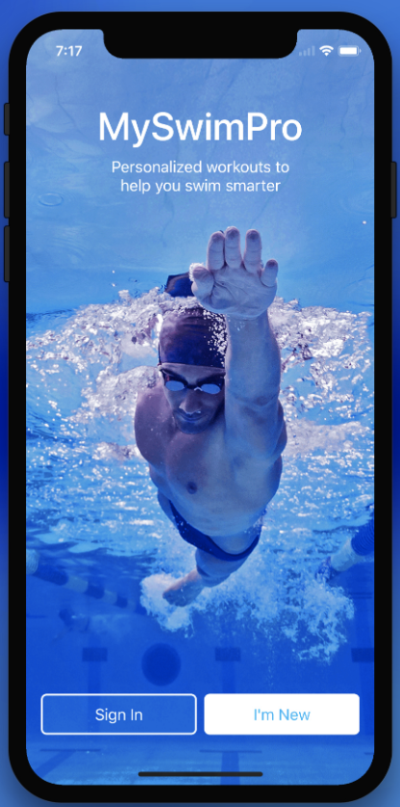
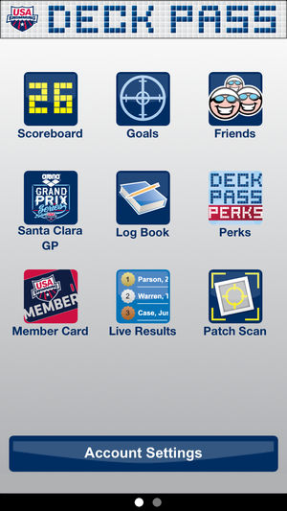
CHALLENGE: TOO MANY APPS
BACKGROUND
My Son Swims Competitively
My Son Is Nationally Ranked
We Want To Track and Report Progress
PROBLEM
Too many applications to track his swims
Meet Mobile
OnDeck
Deck Pass
My Swim Pro
collegeswimming.com
swimmingrank.com
… and many more

Slide 4
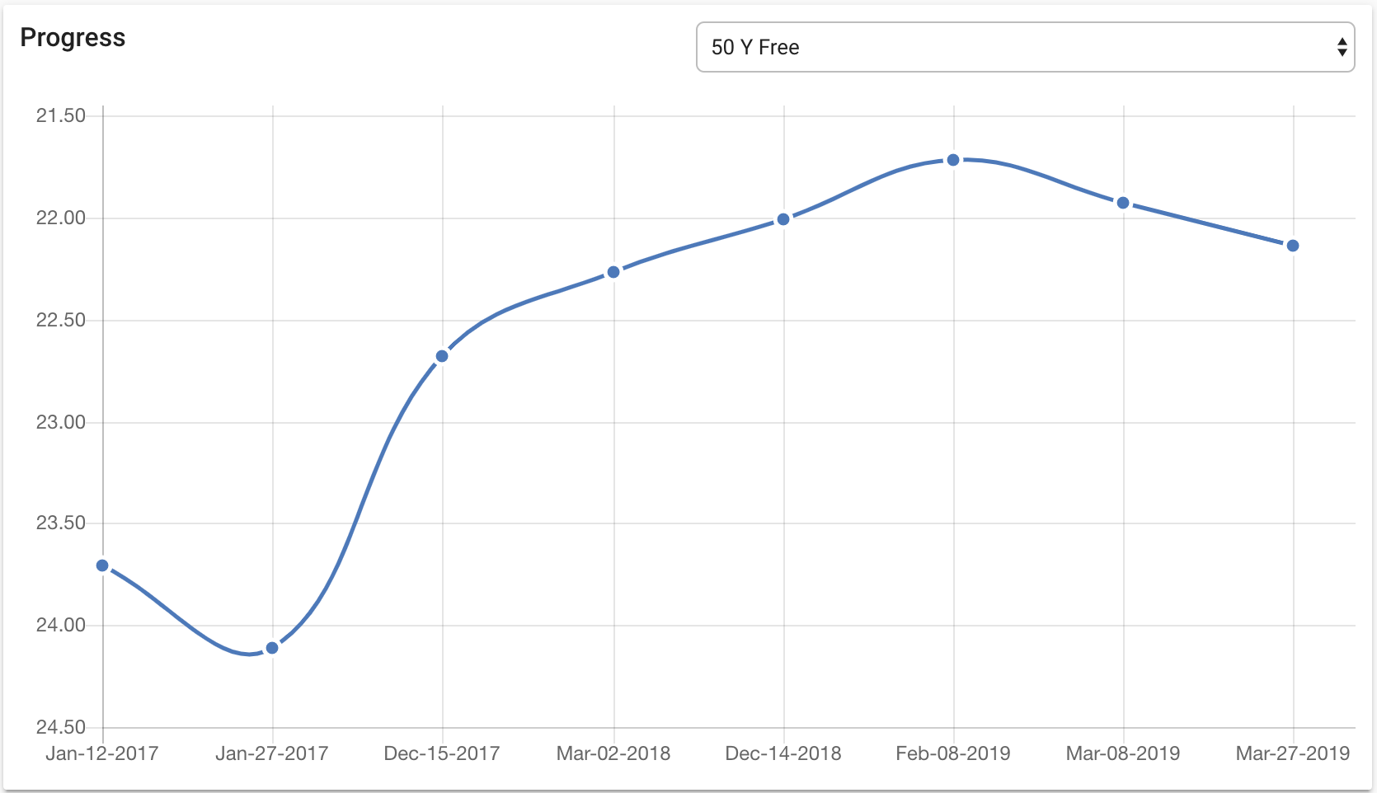
FEATURES
Track Times Automatically
No manual entry
Compare Performance
Swimmer vs. Swimmer
Trend Overtime
Can easily see trendlines
Little or No Cost
Consumption based
Leverage free grants
Sweat equity

Slide 5
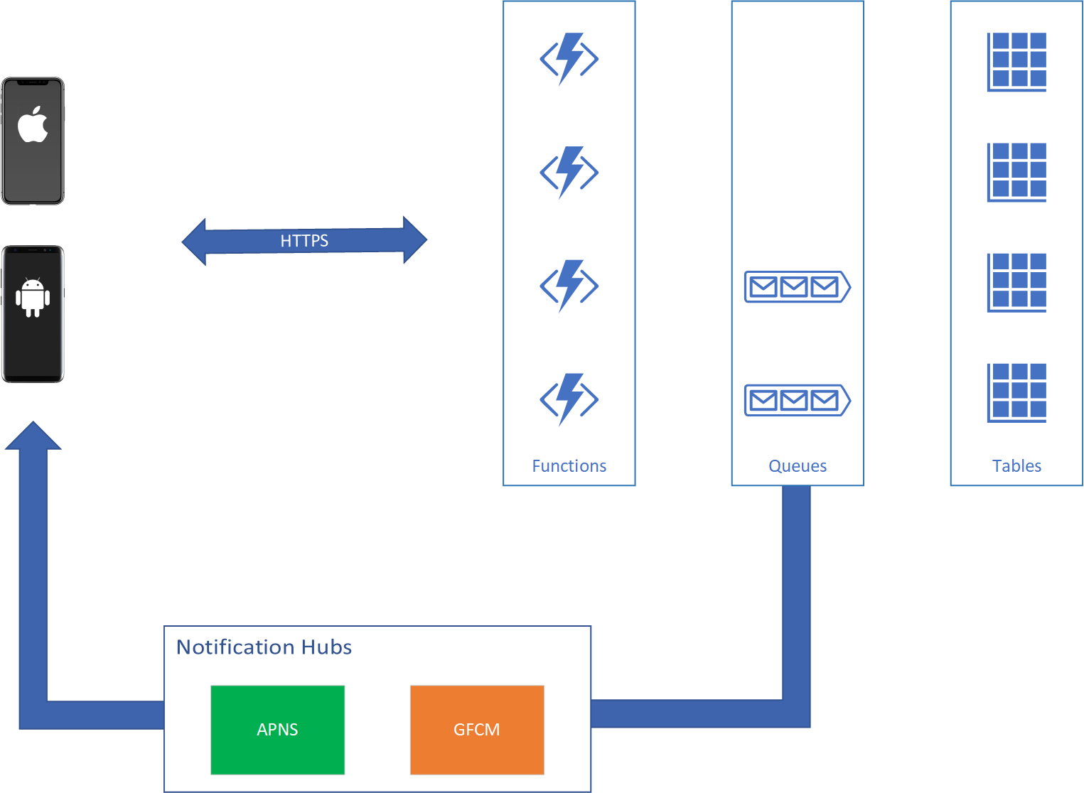
ARCHITECTURE
SERVERLESS
Azure Functions
Queues
Tables
Notification Hubs

Slide 6
SERVERLESS
Serverless Definition
No servers to manage
Consumption based pricing, pay for what you use
Azure Functions
1 million requests consumption per month per subscription
400,000 GB-s of resource consumption per month per subscription
Notification Hubs
Free tier includes 1 million pushes per tier
Table & Queue Storage
Some costs, but really cheap

Slide 7
CHALLENGES ALONG THE WAY
Azure Functions v1 Runtime
Not great when it comes to dependency management
Suffers from a lack of .NET binding redirect support
Azure Functions v2 Runtime
Has been in preview for a long time now
Still waiting for it to become Generally Available (GA)
Cosmos and Table Storage API
Waiting for common API to become released
Conflicted with Azure Functions v1 Runtime

Slide 8
The Tail of 3 .NETs
.NET Framework
Don’t want it, don’t need it
Only used when Azure Functions v1 was around
.NET Standard
Good for sharing code between .NET Framework and .NET Core
Do I still need it if I don’t have .NET Framework?
Short answer is still “Yes”
.NET Core
Awesome! Especially .NET Core 3.0!

Slide 9
SHARING CODE WITH .NET Standard
.NET Standard share code across .NET
Standard which is guaranteed across multiple implementations of .NET
Great for creating common libraries
Our goal was to try and create an application using only .NET Core
We eliminated .NET Framework! Success!
Mono with Xamarin and .NET Core
Not a bad trade off with .NET Standard

Slide 10
Sharing CODE IN PRACTICE
.NET Standard
Great for common library within your solution
Code must adhere to the standard
Ex. swim.Common
Multi-Targeting
Great for creating libraries published to NuGet
Code can account for differences in .NET runtimes
Mostly used #ifdef and compatibility layer
Ex. yocto

Slide 11
Questions

Slide 12
Thanks!
Richard Crane
Web – https://www.mill5.com/innovation/
Twitter – @Rich Crane
GitHub – https://github.com/RichCrane
GitHub – https://github.com/ChiefInnovator
Blog – https://wickedprogrammer.com
LinkedIn – https://www.linkedin.com/in/richardcrane/

